Slide 1
Unit II Electro Analytical Techniques Topic:WA-WB
Conductometric titrations
Dr. P. G. Umape
Pune Institute of Computer Technology

Slide 2
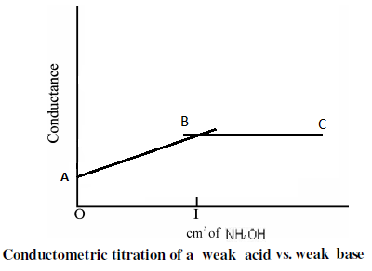
Weak Acid-Weak Base Titration
Consider weak acid CH₃COOH and weak base NH₄OH
CH₃COOH +NH₄OH CH₃COO⁻ + NH₄⁺+ H₂O

Slide 3
Weak Acid-Weak Base Titration
Weak Acid VS Weak Base
CH₃COOH with NH₄OH
In case of weak acid, weak base titration, weak acid is taken in flask while weak base is taken in burette.
As the acid weak it has low dissociation and hence less number of ions and shows low conductivity.
On addition of weak base the neutralisation takes place and a strong electrolyte (CH₃COONH₄ ) is formed along with H₂O.

Slide 4
Weak Acid-Weak Base Titration
Weak Acid VS Weak Base
CH₃COOH with NH₄OH
The CH₃COONH₄ is a strong electrolyte and dissociates completely to CH₃COO⁻ and NH₄⁺ but the ions are bulky hence the conductance increases but slowly.
At equivalence point the conductance is due to CH₃COO⁻ and NH₄⁺ indicating complete neutralization of acid.
After neutralization excess base is added, but the base is weak and dissociation is negligible hence the conductance remains constant or increases very slowly.

Slide 5
Weak Acid-Weak Base Titration
Weak Acid VS Weak Base
CH₃COOH with NH₄OH
In the graph line AB indicate slow rise in conductivity due to neutralization of weak acid and formation of strong electrolyte.
Point B indicate complete neutralisation of acid i.e. equivalence point.
The line BC which is parallel to X axis indicate no increase in conductance and is due to addition of weak base.

Slide 6
Thank you

